Slide 1

Clustering
Notes:
The last two analyses we talked about - differential gene expression and GSEA - are both very much bioinformatic analyses.
In this section, however, we’re going to talk about a more general type of machine learning, and that’s clustering. Or it’s sometimes called class discovery.

Slide 2
Clustering/Class Discovery
Aim: Partition data (e.g. genes or samples) into sub-groups (clusters), such that points of the same cluster are “more similar”.
Example: How many clusters?
One has to choose:
Clustering method
Similarity/distance measure
Evaluate clusters
Notes:
The basic concept of clustering is that we have some data we want to partition. If you can, picture the data as points on a graph. Like you see up on the screen. Now, we want to ask, how many clusters there are. That is, subgroups of data, where the points are similar to each other.
So let me ask you, the audience, how many clusters do you think there are up on the screen? Two? Three? Five? Anyone? <Ask people>
The answer is: This is a trick question. There are a number of clusters somewhere between one and the number of points you see up on the screen. It all depends on how you draw your clusters and which clustering algorithm you use.
<Go through the animation> “There could be one… or two...

Slide 3
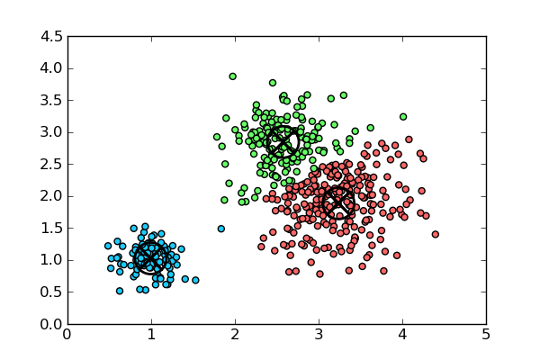
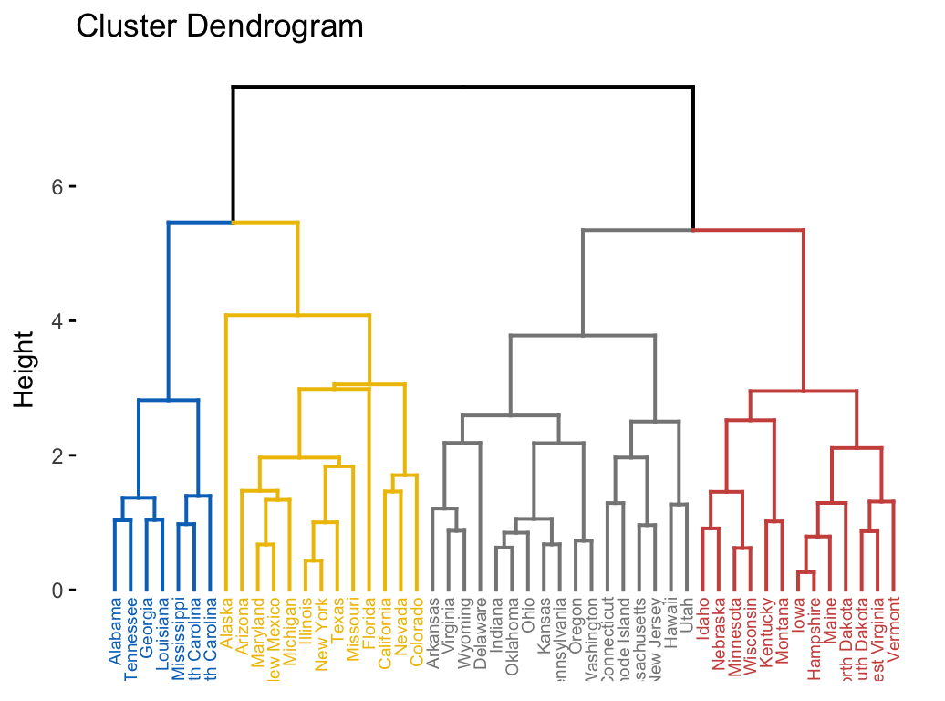
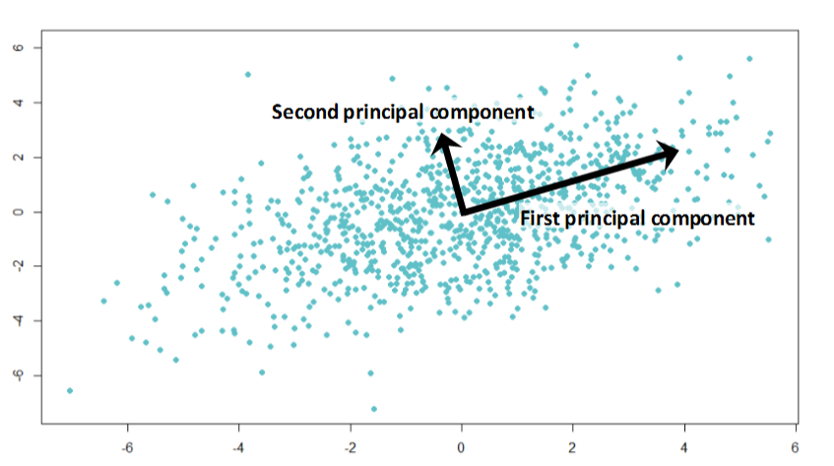
Clustering in GenePattern
Representative based:
Find representatives/centroids of the dataset
K-means
Self Organizing Maps (SOM)
Bottom-up (Agglomerative)
Create an ordering of the data by closeness
Hierarchical clustering
Clustering-like:
Reduce the data to a smaller number of dimensions containing the majority of the information content
NMF (Non-Negative Matrix Factorization)
PCA (Principal Components Analysis)
K-Means Clustering
Hierarchical Clustering
Principal Components Analysis
Notes:
With that in mind, GenePattern supports a variety of clustering and clustering-like methods. These include representative-based methods, such as K-means and SOM. Agglomerative or bottom-up methods, such as hierarchical clustering. And it includes clustering-like methods, which are more properly called dimensionality reduction. And this includes non-negative matrix factorization (NMF) and principal component analysis (PCA).
I want to note that there is no BEST method! For easy problems, most of them work.
Each algorithm has its assumptions, strengths and weaknesses.
And I’m going to go through two of these methods that you will be using today.

Slide 4
K-means Clustering
Initialize centroids at random positions
Iterate:
Assign each data point to its closest centroid
Move centroids to center of assigned points
Stop when converged
Guaranteed to reach a local minimum
K=3
Iteration = 0
Iteration = 1
Iteration = 2
Iteration = 2
Iteration = 1
Notes:
The first is K-means clustering. The algorithm works like this: <walk through the animation>
You start off by picking K random points, where K is the number of clusters you’re looking for. These will be your centroids. You then go through your data and partition it where each point of your data is assigned to the closest centroid.
Given this partitioning, you then move each centroid to the center of the assigned data points. And then you go through and repartition your data, again assigning your points to the closest centroid.
And essentially you repeat this process over and over again, until either you’re gone through a maximum number of iterations, or until your centroids stabilize and stop being moved with each iteration. And you can see from the illustration, that K-means identified these three clusters.
Now, this method is find, but it presupposes that you know the number of clusters you’re looking for a priori. The next method we’re going to look at doesn’t make this assumption.

Slide 5
Hierarchical Clustering
Distance between joined clusters
4
2
5
3
1
1
3
2
4
5
Dendrogram
Notes:
Hierarchical clustering, also called agglomerative clustering, works by building your clusters from the bottom up. <walk through animation>
Thinking of your data as points on a graph again, it begins by numbering each point and then grouping together the two closest points. These become a cluster.
It then groups together the next two closest points, and the next two, and so on, until all of the points have been gathered together. And as you can see, one way to represent this is by building up the dendrogram you see up on your left.

Slide 6
Hierarchical Clustering
Distance between joined clusters
4
2
5
3
1
Linkage is the method for linking clusters based on the distance between them.
Average Linkage: average distance between all pairs
Complete Linkage: farthest distance between all pairs
Single Linkage: closest distance between all pairs
1
3
2
4
5
The dendrogram induces a linear ordering of the data points (up to left/right flip in each split)
Dendrogram
Notes:
Also, when two or more points have been agglomerated into a cluster, we treat that cluster as a single point with a value based its components. That’s called linkage. And there are a number of different ways that can be calculated.

Slide 7
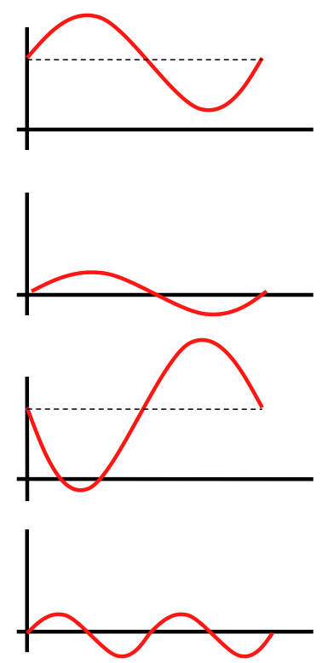
Distance metrics: Pearson and Euclidean
Pearson correlation
Measures linear dependence between genes
“General purpose” distance metric
Invariant to scaling
Invariant to addition by a constant
Euclidean distance
Measures standard distance between two points
Sensitive to scaling
Appropriate for row-normalized data

Slide 8
Reasonable Distance Measure
Euclidean distance on samples and genes on row-centered and normalized data.
Gene 1
Genes: Close -> Correlated
Samples: Similar profile giving Gene 1 and 2 a similar contribution to the distance between sample 1 and 5
Gene 2
Gene 3
Gene 4
Sample 1
Sample 5

Slide 9
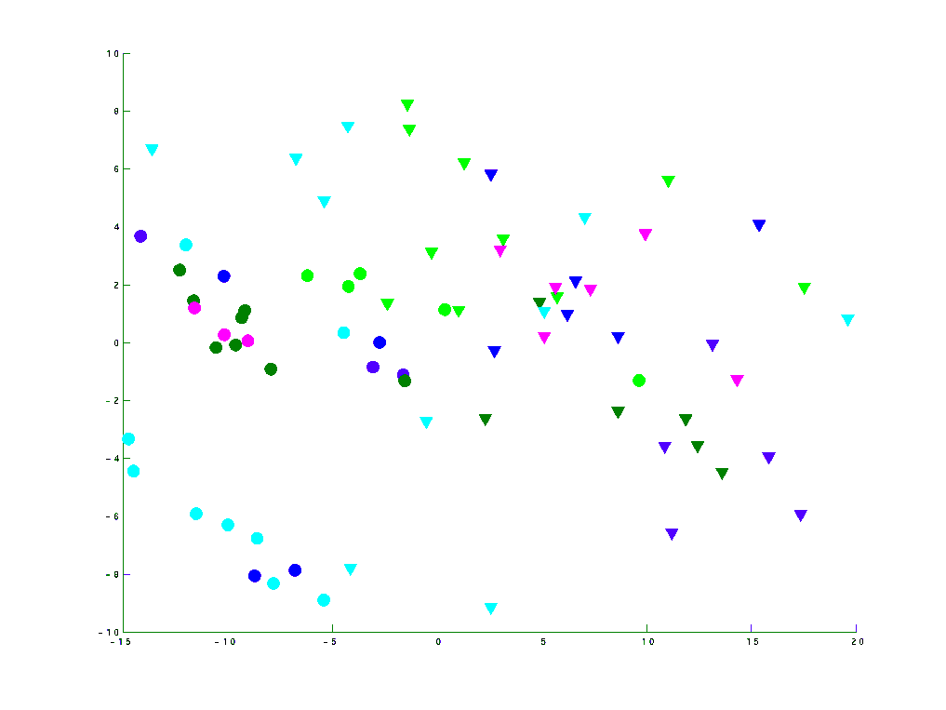
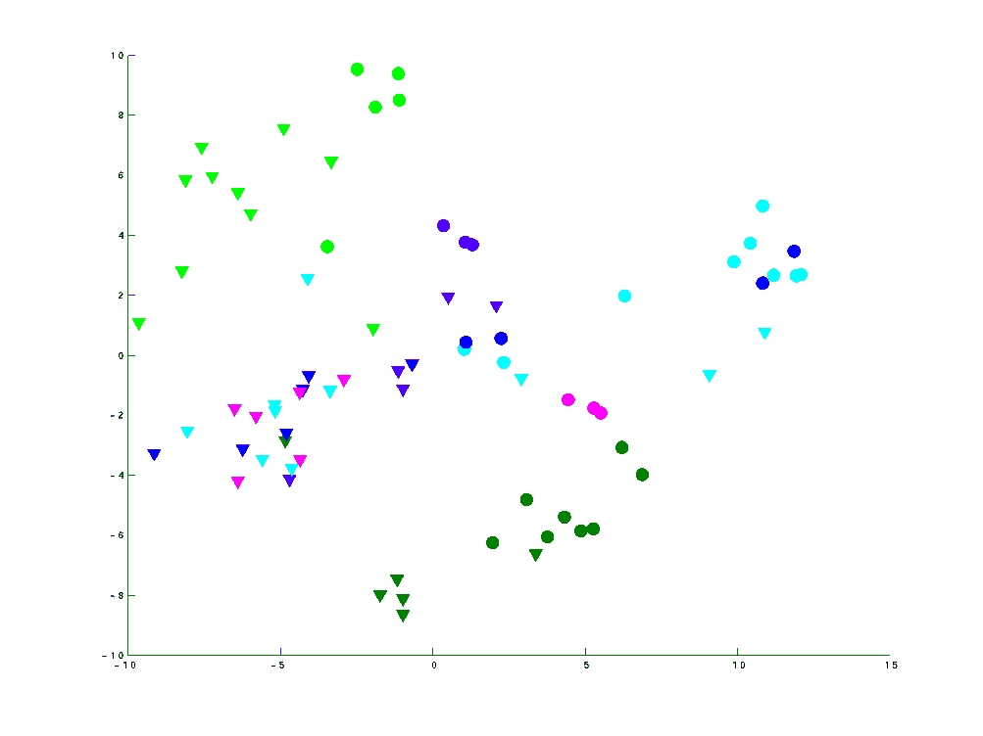
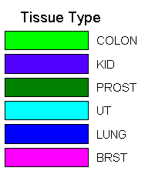
Different Distance Measures
Different distance measures can reveal different structures
Normal/Tumor
Center and normalize rows
Close samples have similar profiles
Tissue type
Center and normalize rows
Center and normalize columns
Close samples have correlated profiles
Euclidean
Pearson
2nd PC
2nd PC
Tumor
Normal
1st PC
1st PC
Data from Lu et al. Nature, 2005

Slide 10
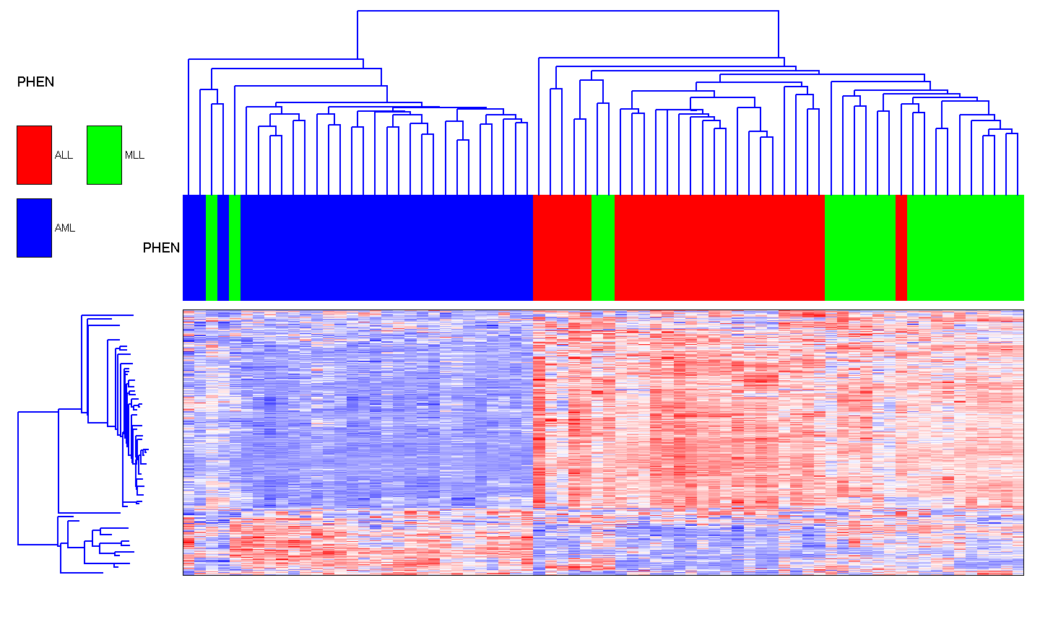
Average Linkage
Leukemia samples and genes

Slide 11
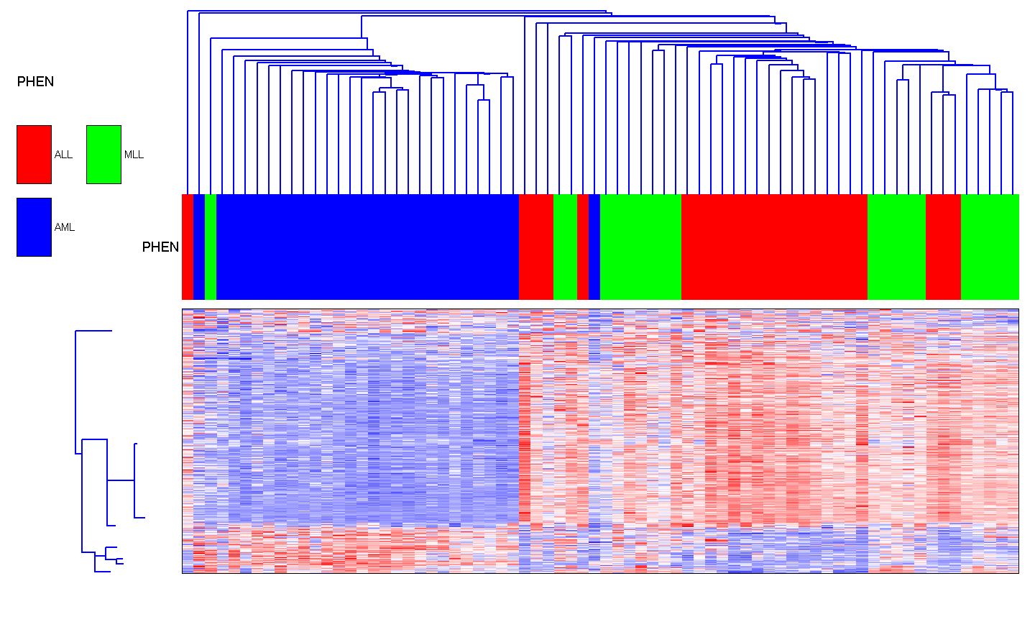
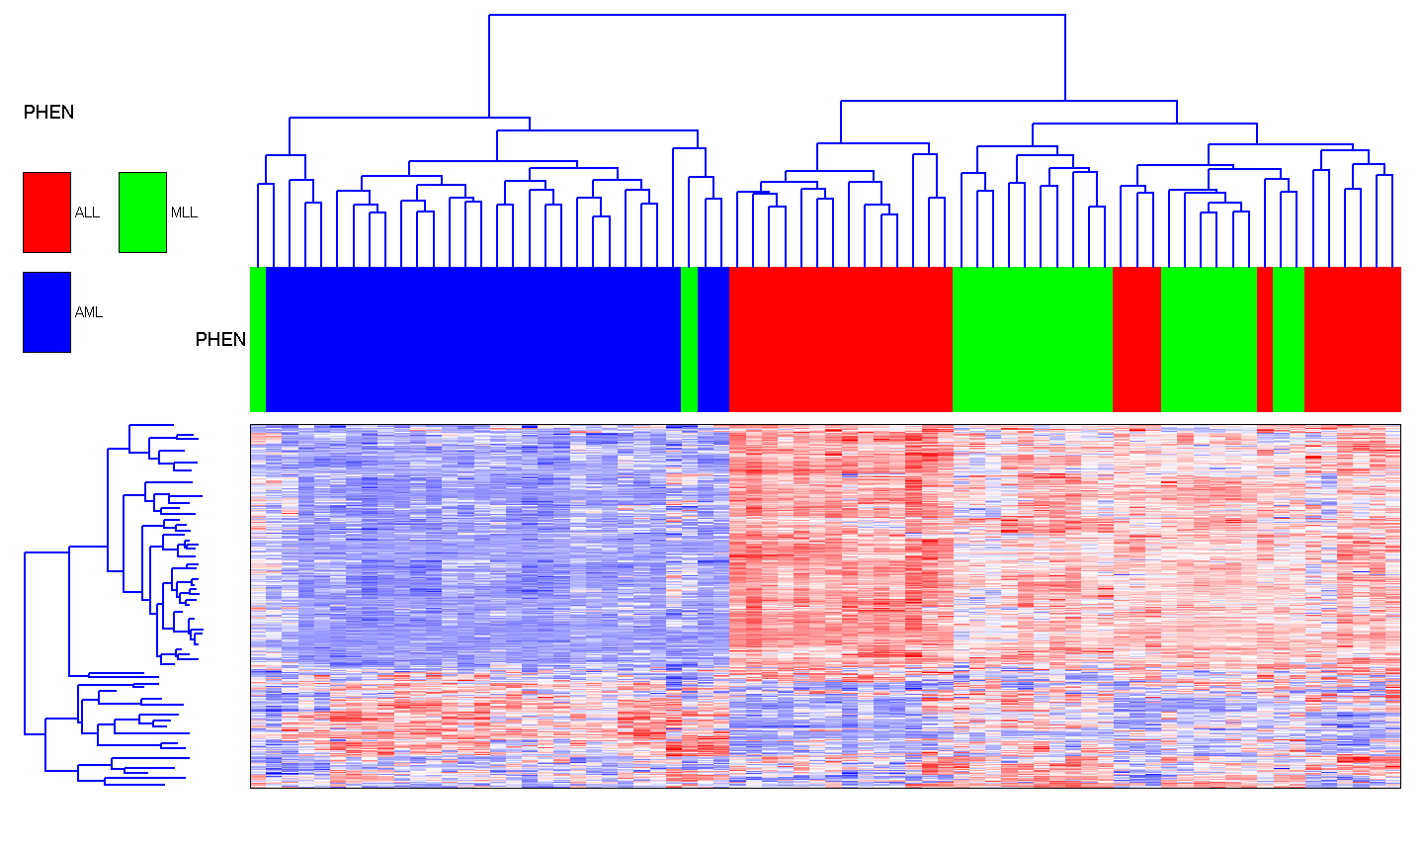
Single and Complete Linkage
Leukemia samples and genes
Single-linkage
Complete-linkage

Slide 12
Similarity/Distance Measures
Decide: which samples/genes should be clustered together
Euclidean: the "ordinary" distance between two points that one would measure with a ruler, and is given by the Pythagorean formula
Pearson correlation - a parametric measure of the strength of linear dependence between two variables.
Absolute Pearson correlation - the absolute value of the Pearson correlation
Spearman rank correlation - a non-parametric measure of independence between two variables
Uncentered correlation - same as Pearson but assumes the mean is 0
Absolute uncentered correlation - the absolute value of the uncentered correlation
Kendall’s tau - a non-parametric similarity measure used to measure the degree of correspondence between two rankings
City-block/Manhattan - the distance that would be traveled to get from one point to the other if a grid-like path is followed

Slide 13
Pitfalls in Clustering
Elongated clusters
Filament
Clusters of different sizes

Slide 14
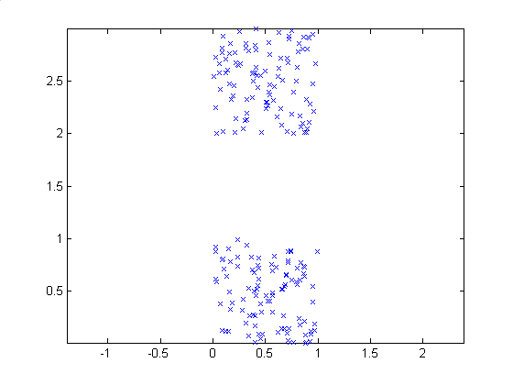
Compact Separated Clusters
All methods work
Adapted from E. Domany

Slide 15
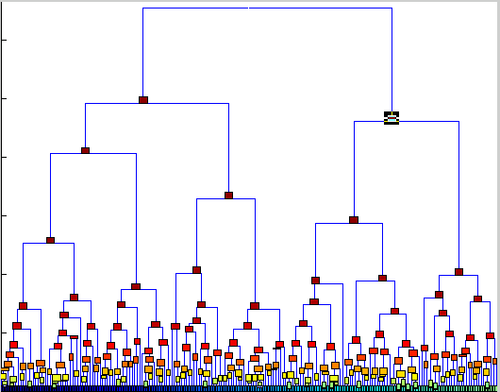
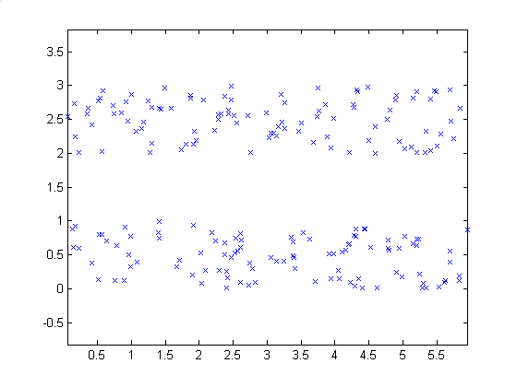
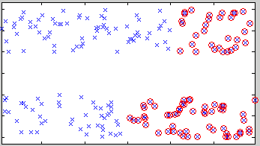
Elongated Clusters
Single linkage succeeds to partition
Average linkage fails

Slide 16
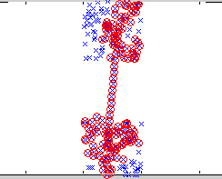
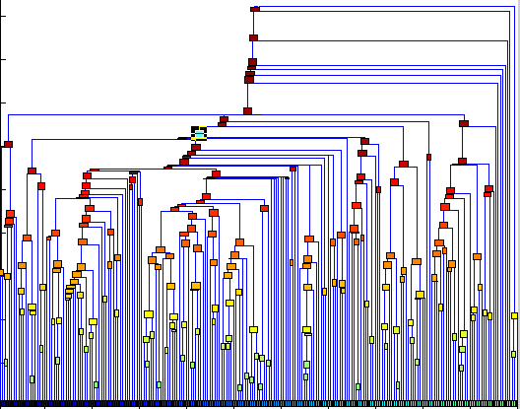
Filament
Single linkage not robust
Adapted from E. Domany

Slide 17
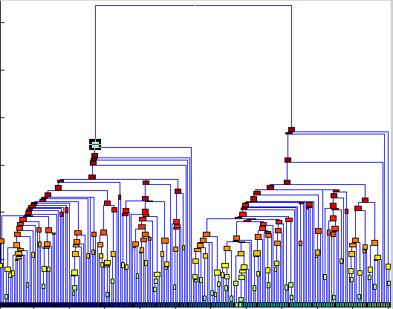
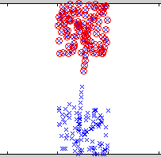
Filament with Point Removed
Single linkage not robust
Adapted from E. Domany

Slide 18
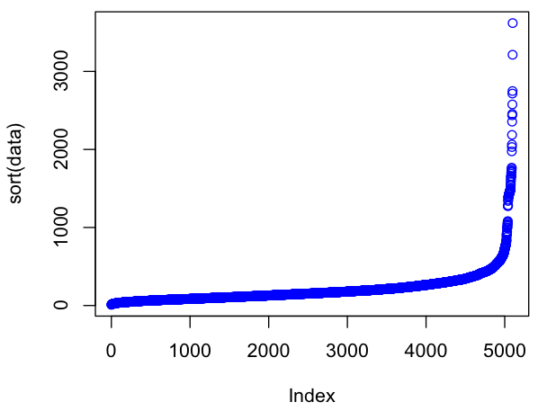
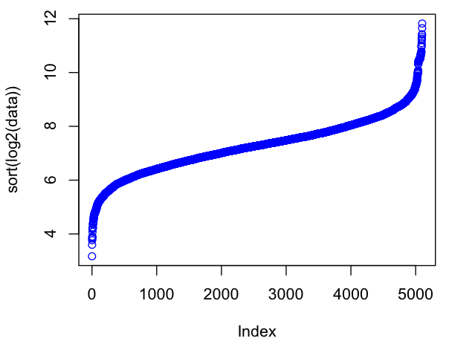
Data Preparation
Row Normalization
Makes genes expressed at different levels comparable to each other
Filtering
Removes lowly-expressed (noisy) and invariant genes
Log transform
Removes outliers by scaling distribution
Expression data after
log transform
Typical distribution of
raw expression data

Slide 19
Two-way Clustering
Two independent cluster analyses on genes and samples used to reorder the data (two-way clustering):

Slide 20
Clustering Exercise
BioITWorld Clustering
Notes:
So with all that being said, let’s start going through the notebook for this section. You can find it by searching the name up on the screen.

